Slide 1
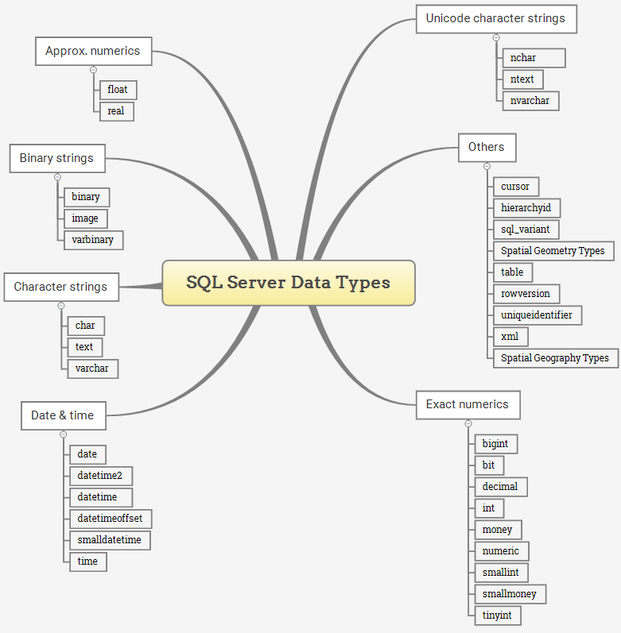

Slide 2
Character strings:
Data type | Description | Storage
char(n) | Fixed-length character string. Maximum 8,000 characters | n
varchar(n) | Variable-length character string. Maximum 8,000 characters
varchar(max) | Variable-length character string. Maximum 1,073,741,824 characters
text | Variable-length character string. Maximum 2GB of text data
Unicode strings:
Data type | Description | Storage
nchar(n) | Fixed-length Unicode data. Maximum 4,000 characters | n
nvarchar(n) | Variable-length Unicode data. Maximum 4,000 characters
ntext | Variable-length Unicode data. Maximum 2GB of text data

Slide 3
Number types or numeric types
Data type | Description | Storage
tinyint | Allows whole numbers from 0 to 255 | 1 byte
smallint | Allows whole numbers between -32,768 and 32,767 | 2 bytes
int | Allows whole numbers between -2,147,483,648 and 2,147,483,647 | 4 bytes
bigint | Allows whole numbers between -9,223,372,036,854,775,808 and 9,223,372,036,854,775,807 | 8 bytes
smallmoney | Monetary data from -214,748.3648 to 214,748.3647 | 4 bytes
money | Monetary data from -922,337,203,685,477.5808 to 922,337,203,685,477.5807 | 8 bytes
float(n) | Floating precision number data from -1.79E + 308 to 1.79E + 308. The n parameter indicates whether the field should hold 4 or 8 bytes. float(24) holds a 4-byte field and float(53) holds an 8-byte field. Default value of n is 53. | 4 or 8 bytes

Slide 4
Number types:
Data type | Description | Storage
real | Floating precision number data from -3.40E + 38 to 3.40E + 38 | 4 bytes
decimal(p,s) | Fixed precision and scale numbers. Allows numbers from -10^38 +1 to 10^38 –1. The p parameter indicates the maximum total number of digits that can be stored (both to the left and to the right of the decimal point). p must be a value from 1 to 38. Default is 18. The s parameter indicates the maximum number of digits stored to the right of the decimal point. s must be a value from 0 to p. Default value is 0 | 5-17 bytes
numeric(p,s) | Fixed precision and scale numbers. Allows numbers from -10^38 +1 to 10^38 –1. The p parameter indicates the maximum total number of digits that can be stored (both to the left and to the right of the decimal point). p must be a value from 1 to 38. Default is 18. The s parameter indicates the maximum number of digits stored to the right of the decimal point. s must be a value from 0 to p. Default value is 0 | 5-17 bytes

Slide 5
Binary types:
Data type | Description | Storage
binary(n) | Fixed-length binary data. Maximum 8,000 bytes
varbinary(n) | Variable-length binary data. Maximum 8,000 bytes
images | 0 bytes to 2,147,483,647 bytes
Date types:
Data type | Description | Storage
datetime | From January 1, 1753 to December 31, 9999 with an accuracy of 3.33 milliseconds | 8 bytes
datetime2 | From January 1, 0001 to December 31, 9999 with an accuracy of 100 nanoseconds | 6-8 bytes
smalldatetime | From January 1, 1900 to June 6, 2079 with an accuracy of 1 minute | 4 bytes
date | Store a date only. From January 1, 0001 to December 31, 9999 | 3 bytes
time | 00:00:00.0000000 to 23:59:59.9999999 | 5 bytes

Slide 6
Other data types:
Data type | Description
sql_variant | Stores up to 8,000 bytes of data of various data types, except text, ntext, and timestamp
uniqueidentifier | Stores a globally unique identifier (GUID)
xml | Stores XML formatted data. Maximum 2GB
Table | store a result set temporarily for processing at a later time
cursor | Stores a reference to a cursor used for database operations

